Slide 1
Data Structures Workshop
Day 25

Slide 2
Workshop Outline
AVL Trees
More AVL Deletion Practice
B-Trees
Theory
Insertion Explanation
Insertion Tracing Example

Slide 3
AVL Deletion
Deletion to AVL Trees is very similar to that of BST’s.
The only difference here is that after the deletion, we need to check and see if there’s any rebalancing we need to do due to the deletion.
Again, keep in mind the 3 cases we can expect when deleting from an AVL tree:
Deleting a node with no children nodes
Deleting a node with 1 child node
Deleting a node with 2 children nodes

Slide 4
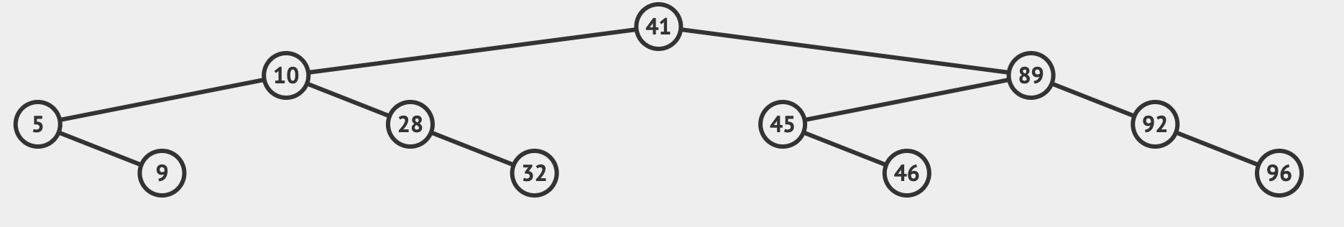
Deletion Practice
Given the following AVL tree, perform the following operations:
Delete 28
Delete 89
Delete 32

Slide 5
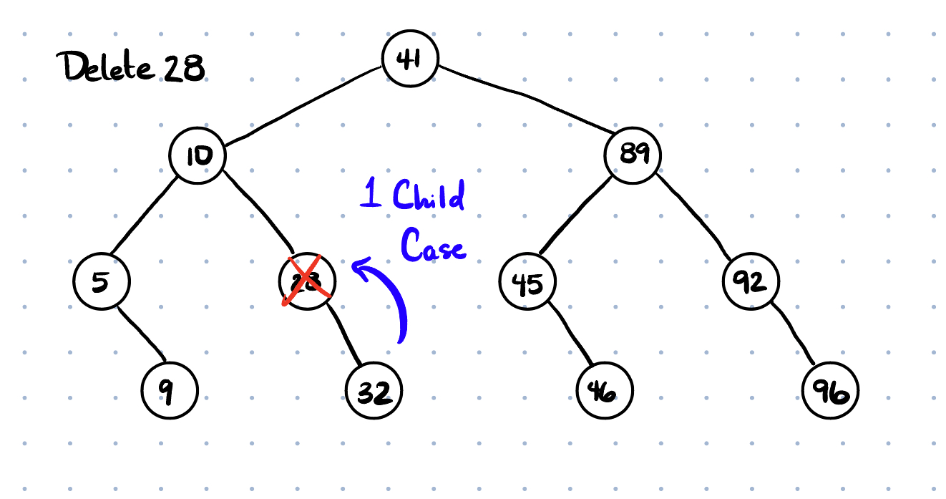

Slide 6
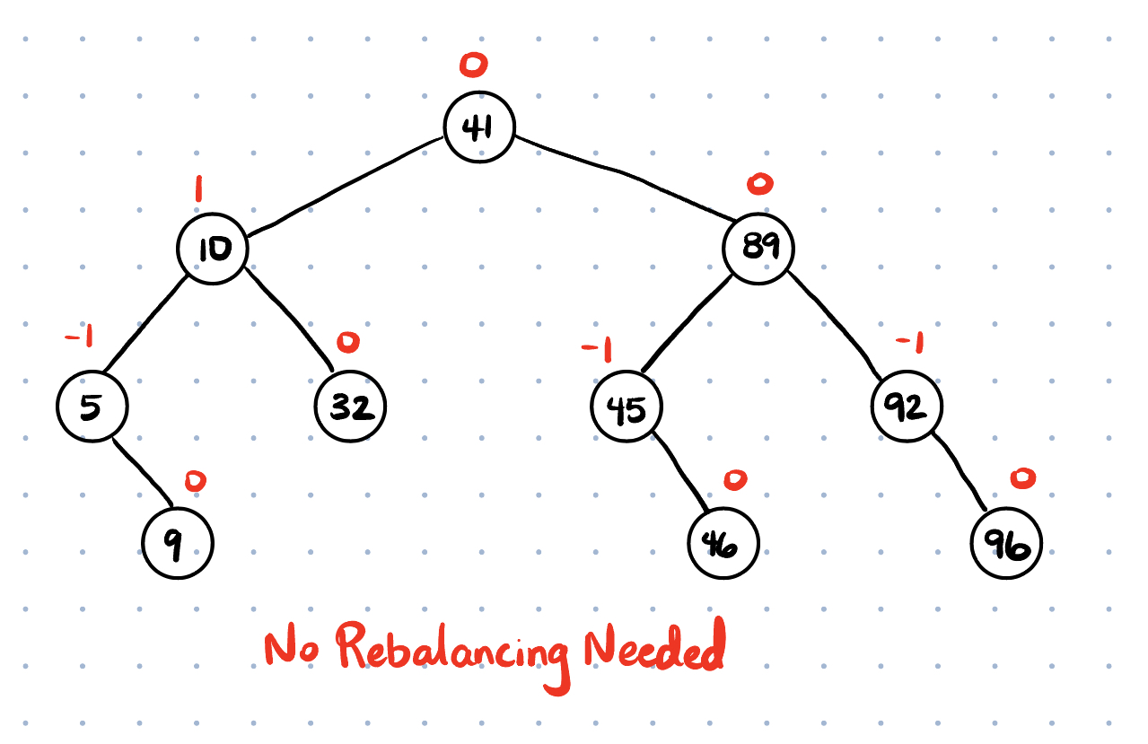
After the deletion, we re-check the Balance Factor and make sure our AVL tree is balanced

Slide 7
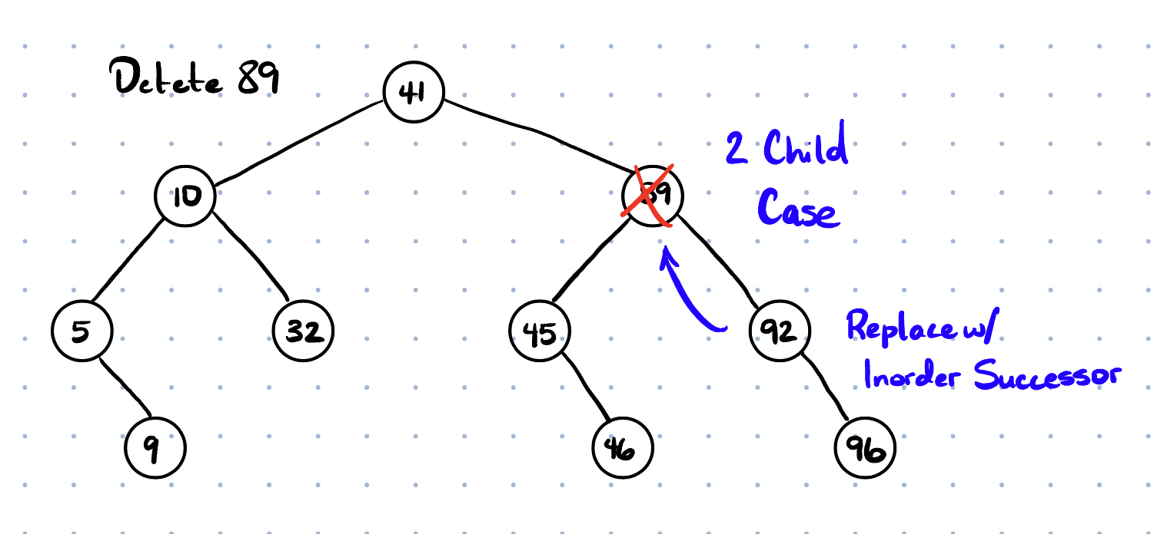
Keep in mind that the problem can ask to use the inorder successor or predecessor

Slide 8
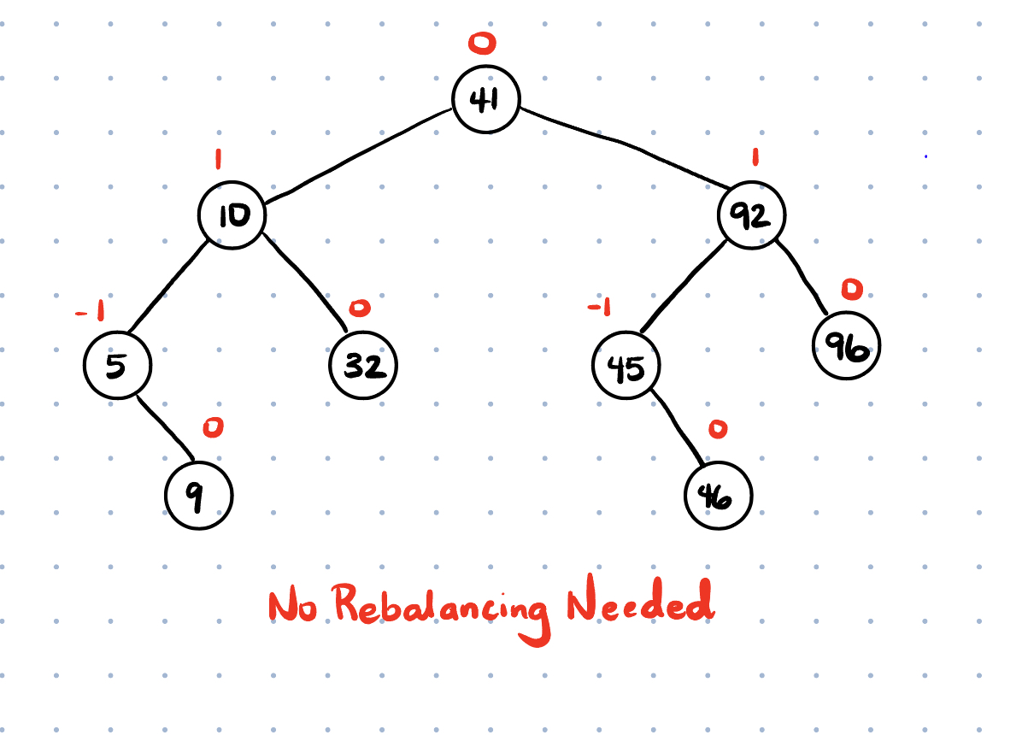

Slide 9
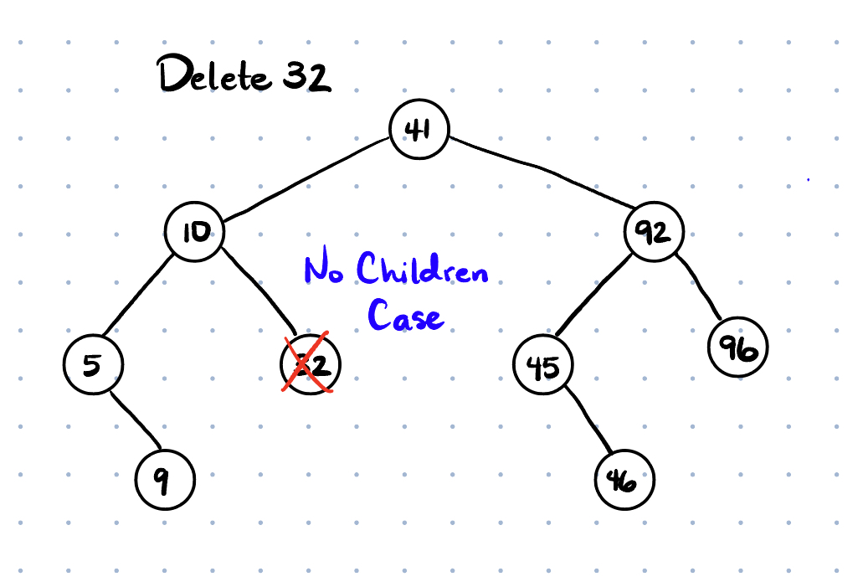

Slide 10
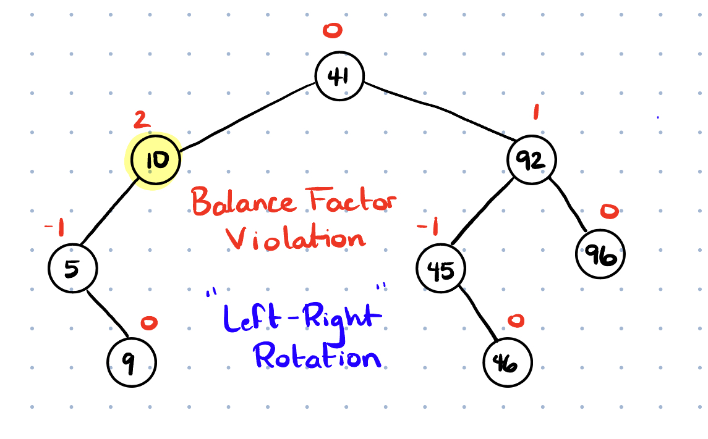

Slide 11
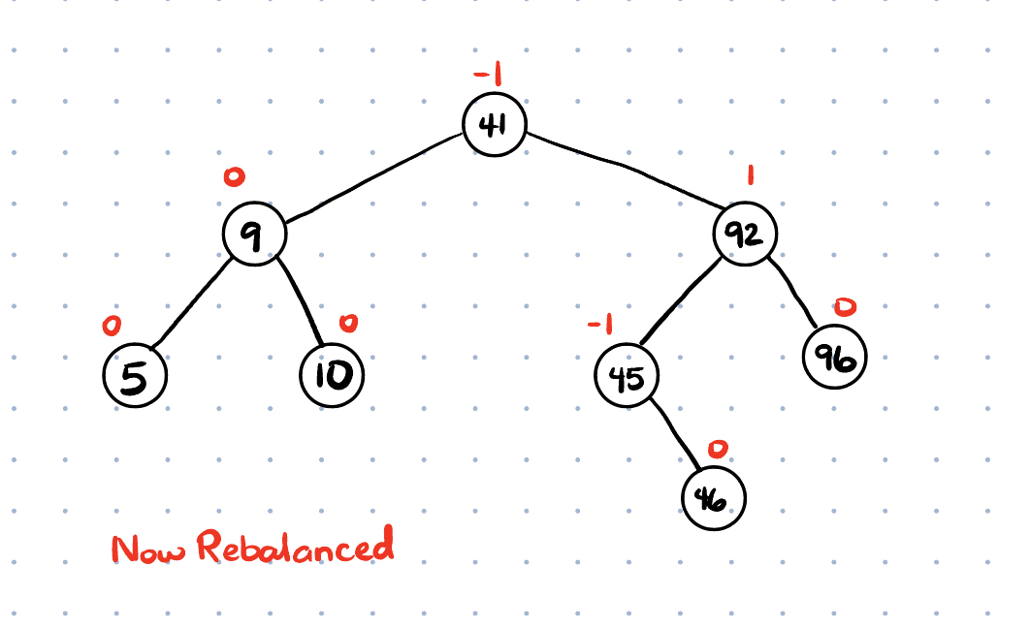

Slide 12
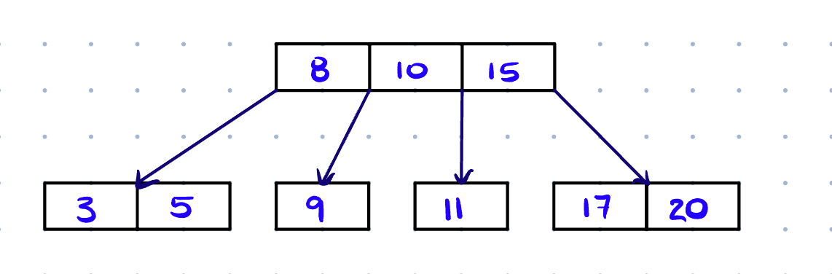
B-Trees
A B-Tree is a special type of self-balancing search tree in which each node can contain more than one value (key) and can have more than two children.
Optimization over BST’s and AVL Trees
The balanced nature of B-trees ensures that their height remains logarithmic, making them efficient for large datasets

Slide 13
B Tree Insertion Steps
Traverse from the root down to a leaf node (make sure you traverse and maintain the order of values within each node)
Once you reach a leaf node, insert into the correct position
If the node already has n (degree - 1) values, or is full:
Split the node in half
Take the middle node and move it up as the parent
If there is even number of values, take either left middle or right middle, just be consistent
Values on the left of the middle are now the left children on that value, and values on the right are now the right children

Slide 14
B Tree Insertion Practice
Given a B Tree of maximum degree 4, insert the following values and construct the B Tree:
20, 13, 6, 18, 14, 10, 11, 25, 8, 30, 22
Note: Remember the steps to insertion, when do we perform the split in the child node? What node will be pushed up when the split occurs?

Slide 15
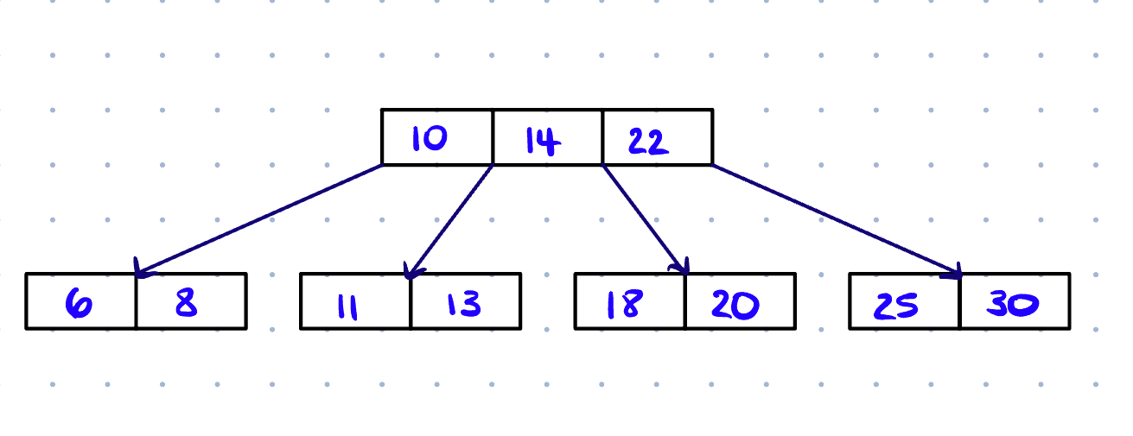
Solution

Slide 16
Final Exam Material
BST and AVL Trees
Know how to perform in-order, pre-order, post-order and reverse order traversals
Know how to perform basic ADT functions (insert, search, getHeight, balanceFactor, delete) for each tree type
Know how to do insertion and deletion tracing for both BST and AVL
Understand rotations for AVL
Practice other BST function implementations (printLeaves, getSum, etc)

Slide 17
BST Problems

Slide 18
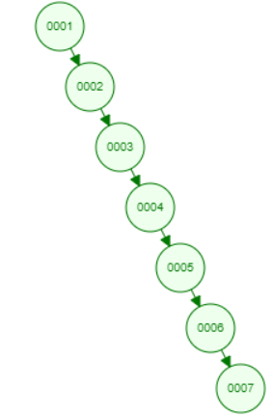
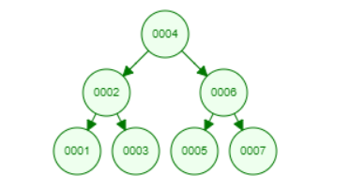
Increasing Order Search Tree 5 min
Given the root of a binary search tree, rearrange the tree in in-order so that the leftmost node in the tree is now the root of the tree, and every node has no left child and only one right child.

Slide 19
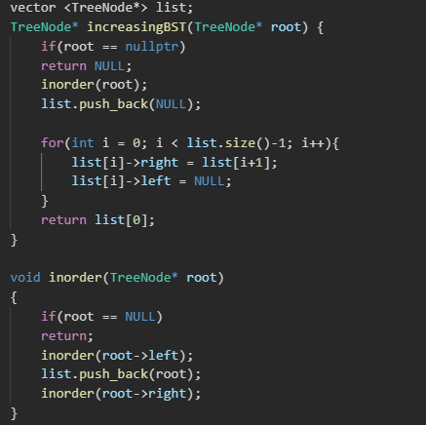
Solution

Slide 20
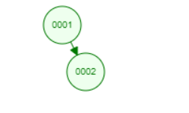
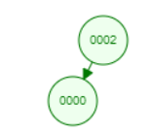
Two Binary Search Trees 10 min
Given two binary search trees Root 1 and Root 2, return a list containing all the integers from both trees sorted in ascending order.
Output: [0, 1, 2, 2]

Slide 21
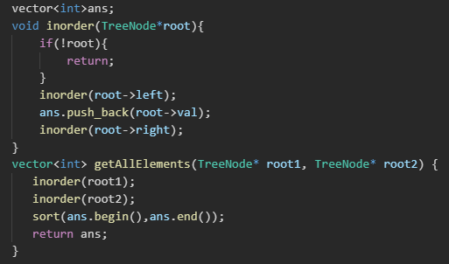
Solutions

Slide 22
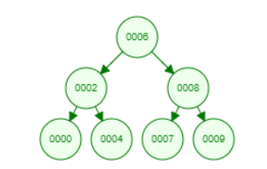
Lowest Common Ancestor 10 min
Given a binary search tree (BST), find the lowest common ancestor (LCA) node of two given nodes in the BST.
Ex: Node1 = 2, Node2 = 8
Output: 6
Ex: Node1 = 2, Node2 = 4
Output: 2

Slide 23
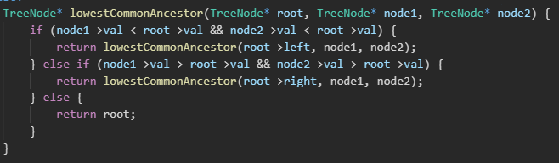
Solution

